Slide 1
DESIGN CONCEPTS AND ARCHITECTURAL DESIGN
Session 10
Course : Software Engineering
Effective Period : Desember 2017

Slide 2
These slides have been adapted from
Pressman, R.S. (2015). Software Engineering : A Practioner's Approach. 8th ed. McGraw-Hill Companies.Inc, Americas, New York. ISBN : 978 1 259 253157. Chapter 12 and 13
Acknowledgement

Slide 3
LO 2 : Explain the software engineering practices
Learning Objectives

Slide 4
Contents
Design within the Context of Software Engineering
The Design Process
Design Concepts
The Design Models
Software Architecture
Architectural Genres
Architectural Styles
Architectural Design
Analyzing Architectural Designs

Slide 5

Design Within the Context of Software Engineering
Translating the requirements model into
the design model

Slide 6
Three characteristics of agood design
The Design Process
the design must implement all of the explicit requirements contained in the analysis model, and it must accommodate all of the implicit requirements desired by the customer.
the design must be a readable, understandable guide for those who generate code and for those who test and subsequently support the software.
the design should provide a complete picture of the software, addressing the data, functional, and behavioral domains from an implementation perspective.

Slide 7
The Design Process
Quality Guidelines
A design should exhibit an architecture
A design should be modular
A design should contain distinct representations.
A design should lead to data structures that are appropriate.
A design should lead to components that exhibit independent functional characteristics.
A design should lead to interfaces that reduce the complexity.
A design should be derived using a repeatable method.
A design should be represented using a notation that effectively communicates its meaning.

Slide 8
Design Concepts
Architecture
“The overall structure of the software and the ways in which that structure provides conceptual integrity for a system.” [SHA95a]
Structural properties. This aspect of the architectural design representation defines the components of a system (e.g., modules, objects, filters) and the manner in which those components are packaged and interact with one another. For example, objects are packaged to encapsulate both data and the processing that manipulates the data and interact via the invocation of methods
Extra-functional properties. The architectural design description should address how the design architecture achieves requirements for performance, capacity, reliability, security, adaptability, and other system characteristics.
Families of related systems. The architectural design should draw upon repeatable patterns that are commonly encountered in the design of families of similar systems. In essence, the design should have the ability to reuse architectural building blocks.

Slide 9
Design Concepts
Patterns
Design Pattern Template
Pattern name - describes the essence of the pattern in a short but expressive name
Intent - describes the pattern and what it does
Also-known-as - lists any synonyms for the pattern
Motivation - provides an example of the problem
Applicability - notes specific design situations in which the pattern is applicable
Structure - describes the classes that are required to implement the pattern
Participants - describes the responsibilities of the classes that are required to implement the pattern
Collaborations - describes how the participants collaborate to carry out their responsibilities
Consequences - describes the “design forces” that affect the pattern and the potential trade-offs that must be considered when the pattern is implemented
Related patterns - cross-references related design patterns

Slide 10
Design Concepts
Separation of Concerns
Any complex problem can be more easily handled if it is subdivided into pieces that can each be solved and/or optimized independently
A concern is a feature or behavior that is specified as part of the requirements model for the software
By separating concerns into smaller, and therefore more manageable pieces, a problem takes less effort and time to solve.

Slide 11
Design Concepts
Modularity
"modularity is the single attribute of software that allows a program to be intellectually manageable" [Mye78].
Monolithic software (i.e., a large program composed of a single module) cannot be easily grasped by a software engineer.
  The number of control paths, span of reference, number of variables, and overall complexity would make understanding close to impossible.
In almost all instances, you should break the design into many modules, hoping to make understanding easier and as a consequence, reduce the cost required to build the software.

Slide 12
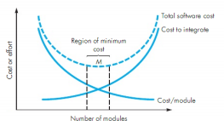
Design Concepts
Modularity and software cost

Slide 13
Design Concepts
Why Information Hiding?
reduces the likelihood of “side effects”
limits the global impact of local design decisions
emphasizes communication through controlled interfaces
discourages the use of global data
leads to encapsulation—an attribute of high quality design
results in higher quality software

Slide 14
Design Concepts
Stepwise Refinement
open
walk to door;
reach for knob;
open door;
repeat until door opens
turn knob clockwise;
walk through;
if knob doesn't turn, then
close door.
take key out;
find correct key;
insert in lock;
endif
pull/push door
move out of way;
end repeat

Slide 15
Design Concepts
Functional Independence
Functional independence is achieved by developing modules with "single-minded" function and an "aversion" to excessive interaction with other modules.
Cohesion is an indication of the relative functional strength of a module.
  A cohesive module performs a single task, requiring little interaction with other components in other parts of a program. Stated simply, a cohesive module should (ideally) do just one thing.
Coupling is an indication of the relative interdependence among modules.
  Coupling depends on the interface complexity between modules, the point at which entry or reference is made to a module, and what data pass across the interface.

Slide 16
Design Concepts
Aspects
Consider two requirements, A and B. Requirement A crosscuts requirement B “if a software decomposition [refinement] has been chosen in which B cannot be satisfied without taking A into account. [Ros04]
An aspect is a representation of a cross-cutting concern.

Slide 17
Design Concepts
Refactoring
Fowler [FOW99] defines refactoring in the following manner:
  "Refactoring is the process of changing a software system in such a way that it does not alter the external behavior of the code [design] yet improves its internal structure.”
When software is refactored, the existing design is examined for
  redundancy
  unused design elements
  inefficient or unnecessary algorithms
  poorly constructed or inappropriate data structures
  or any other design failure that can be corrected to yield a better design.

Slide 18
Design Concepts
OO Design Concepts
Design classes
  Entity classes
  Boundary classes
  Controller classes
Inheritance—all responsibilities of a superclass is immediately inherited by all subclasses
Messages—stimulate some behavior to occur in the receiving object
Polymorphism—a characteristic that greatly reduces the effort required to extend the design

Slide 19
Design Concepts
Design Classes
Analysis classes are refined during design to become entity classes
Boundary classes are developed during design to create the interface (e.g., interactive screen or printed reports) that the user sees and interacts with as the software is used.
  Boundary classes are designed with the responsibility of managing the way entity objects are represented to users.
Controller classes are designed to manage
  the creation or update of entity objects;
  the instantiation of boundary objects as they obtain information from entity objects;
  complex communication between sets of objects;
  validation of data communicated between objects or between the user and the application.

Slide 20
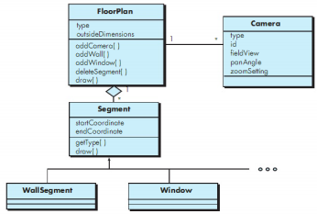
Design Concepts
Design class for FloorPlan and composite aggregation for the class

Slide 21

The Design Model
Dimensions of the design model

Slide 22
The Design Model
Design Model Elements
Data elements
  Data model --> data structures
  Data model --> database architecture
Architectural elements
  Application domain
  Analysis classes, their relationships, collaborations and behaviors are transformed into design realizations
  Patterns and “styles”
Interface elements
  the user interface (UI)
  external interfaces to other systems, devices, networks or other producers or consumers of information
  internal interfaces between various design components.
Component elements
Deployment elements

Slide 23
The Design Model
Architectural Elements
The architectural model [Sha96] is derived from three sources:
  information about the application domain for the software to be built;
  specific requirements model elements such as data flow diagrams or analysis classes, their relationships and collaborations for the problem at hand, and
  the availability of architectural patterns and styles

Slide 24
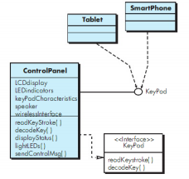
The Design Model
Interface Design Elements
Interface representation for ControlPanel

Slide 25
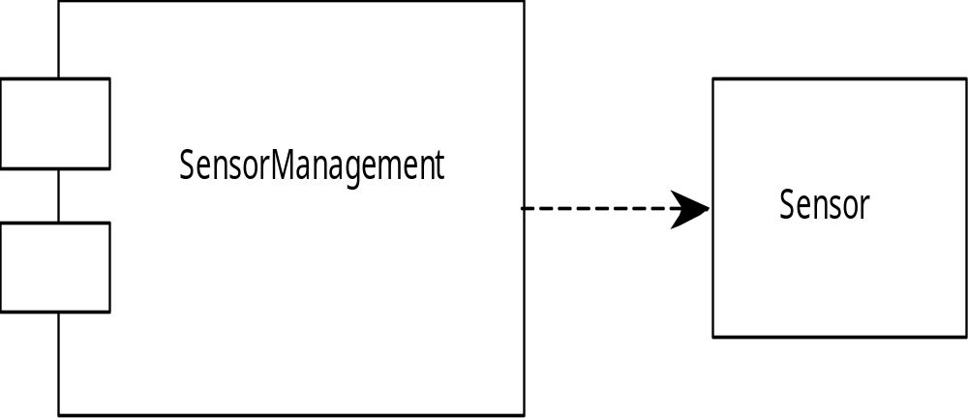
The Design Model
Component Elements

Slide 26
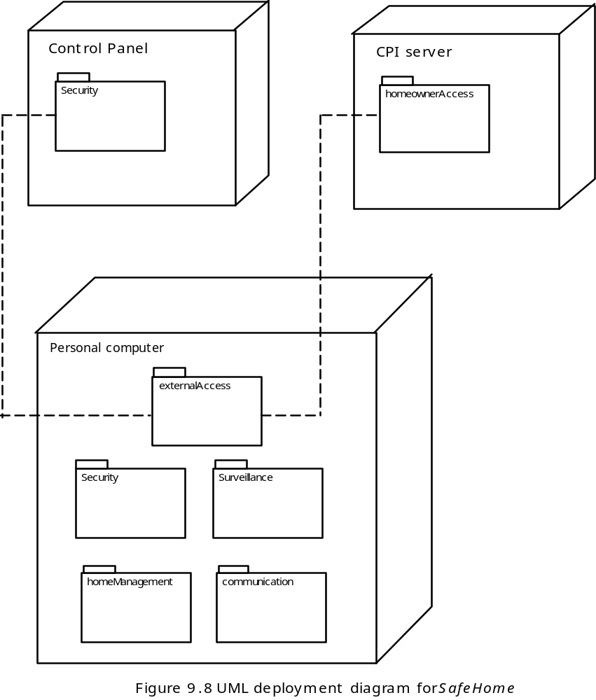
The Design Model
Deployment Elements

Slide 27
Software Architecture
Why Architecture?
The architecture is not the operational software. Rather, it is a representation that enables a software engineer to:
(1) analyze the effectiveness of the design in meeting its stated requirements,
(2) consider architectural alternatives at a stage when making design changes is still relatively easy, and
(3) reduce the risks associated with the construction of the software.

Slide 28
Software Architecture
Why is Architecture Important?
Representations of software architecture are an enabler for communication between all parties (stakeholders) interested in the development of a computer-based system.
The architecture highlights early design decisions that will have a profound impact on all software engineering work that follows and, as important, on the ultimate success of the system as an operational entity.
Architecture “constitutes a relatively small, intellectually graspable mode of how the system is structured and how its components work together” [BAS03].

Slide 29
Software Architecture
Architectural Descriptions
The IEEE Computer Society has proposed IEEE-Std-1471-2000, Recommended Practice for Architectural Description of Software-Intensive System, [IEE00]
  to establish a conceptual framework and vocabulary for use during the design of software architecture,
  to provide detailed guidelines for representing an architectural description, and
  to encourage sound architectural design practices.
The IEEE Standard defines an architectural description (AD) as a “a collection of products to document an architecture.”
  The description itself is represented using multiple views, where each view is “a representation of a whole system from the perspective of a related set of [stakeholder] concerns.”

Slide 30
Architecture Genres
Genre implies a specific category within the overall software domain.
Within each category, you encounter a number of subcategories.
  For example, within the genre of buildings, you would encounter the following general styles: houses, condos, apartment buildings, office buildings, industrial building, warehouses, and so on.
  Within each general style, more specific styles might apply. Each style would have a structure that can be described using a set of predictable patterns.

Slide 31
Architectural Styles
Each style describes a system category that encompasses: (1) a set of components (e.g., a database, computational modules) that perform a function required by a system, (2) a set of connectors that enable “communication, coordination and cooperation” among components, (3) constraints that define how components can be integrated to form the system, and (4) semantic models that enable a designer to understand the overall properties of a system by analyzing the known properties of its constituent parts.
Data-centered architectures
Data flow architectures
Call and return architectures
Object-oriented architectures
Layered architectures

Slide 32
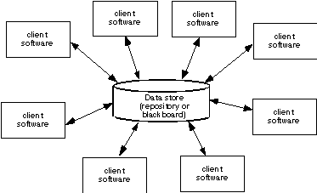
Architectural Styles
Data-Centered Architecture

Slide 33
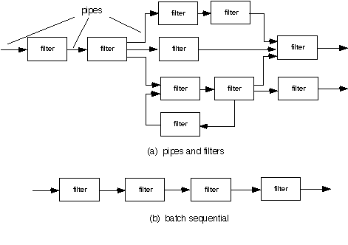
Architectural Styles
Data Flow Architecture

Slide 34
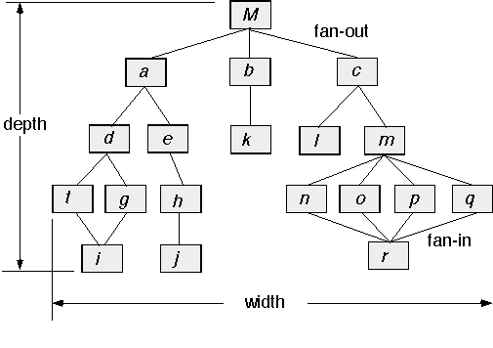
Architectural Styles
Call and Return Architecture

Slide 35
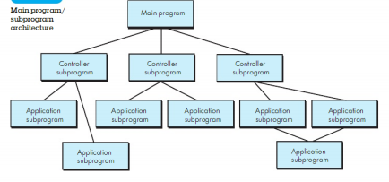
Architectural Styles
Main program/subprogram architecture

Slide 36
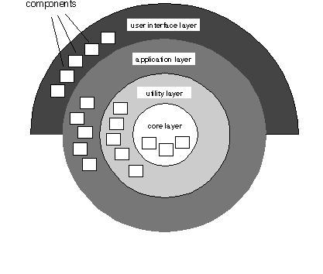
Architectural Styles
Layered Architecture

Slide 37
Architectural Design
The software must be placed into context
  the design should define the external entities (other systems, devices, people) that the software interacts with and the nature of the interaction
A set of architectural archetypes should be identified
  An archetype is an abstraction (similar to a class) that represents one element of system behavior
The designer specifies the structure of the system by defining and refining software components that implement each archetype

Slide 38
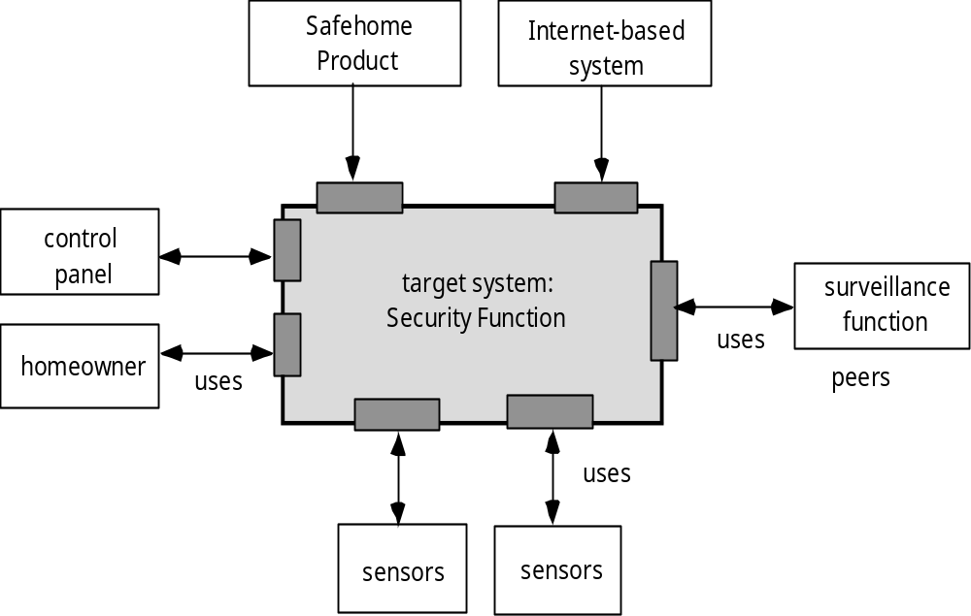
Architectural Design
Architectural context diagram for SafeHome security function

Slide 39
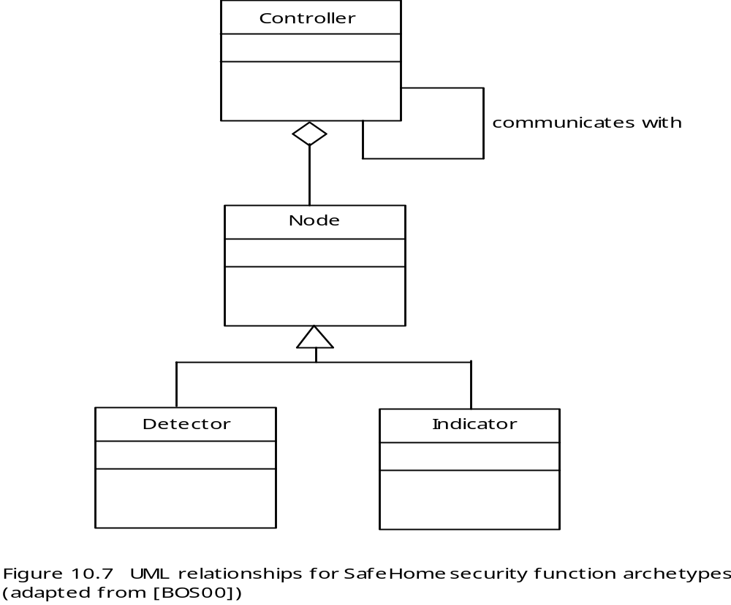
Architectural Design
Archetypes

Slide 40
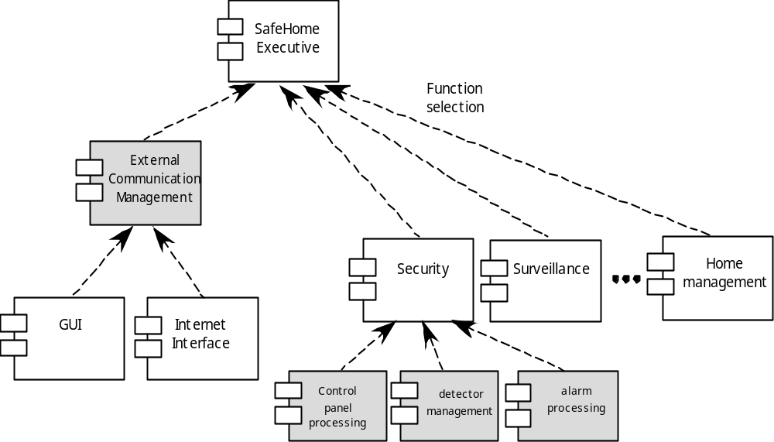
Architectural Design
Component Structure

Slide 41
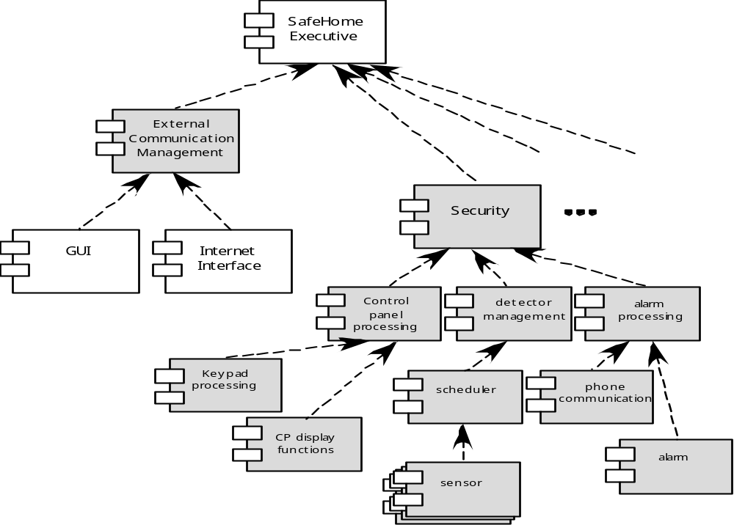
Architectural Design
Refined Component Structure

Slide 42
Analyzing Architectural Design
1. Collect scenarios.
2. Elicit requirements, constraints, and environment description.
3. Describe the architectural styles/patterns that have been chosen to address the scenarios and requirements:
• module view
• process view
• data flow view
4. Evaluate quality attributes by considered each attribute in isolation.
5. Identify the sensitivity of quality attributes to various architectural attributes for a specific architectural style.
6. Critique candidate architectures (developed in step 3) using the sensitivity analysis conducted in step 5.

Slide 43
References
Pressman, R.S. (2015). Software Engineering : A Practioner's Approach. 8th ed. McGraw-Hill Companies.Inc, Americas, New York. ISBN : 978 1 259 253157.
E.Yourdon, IT Software and IT Expert Witness Services ,
http://yourdon.com/litigation_support

Slide 44
Q & A

